Slide 1
LARGE SCALE DATA ANALYTICS
Title : Airline Delay Predictive Analysis
S.Name : Venkat Sai Manoj Cheerla
S.ID : 0863427

Slide 2
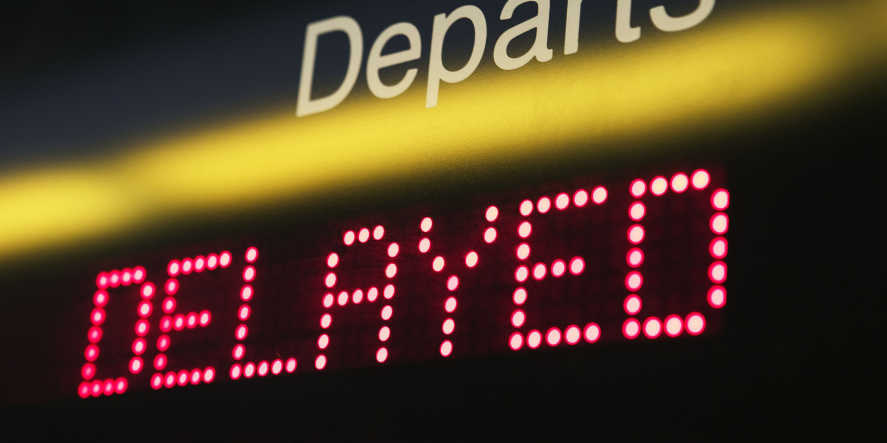
Introduction: Problem definition that your solution addresses
Predict flight delays
Flight delays are a major problem within the airline industry as it leads to financial losses and negative impact on business reputation. 
Examine causes for flight delays
This project explores what factors influence the occurrence of flight delays.

Slide 3
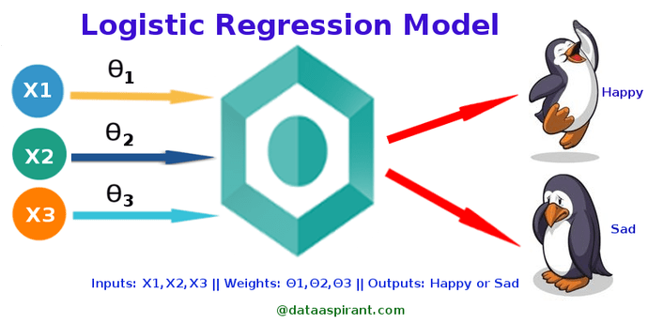
The possible solution is Logistic Regression
Form of regression that allows the prediction of discrete variables by a mix of continuous and discrete predictors.
Addresses the same questions that discriminant function analysis and multiple regression do but with no distributional assumptions on the predictors (the predictors do not have to be normally distributed, linearly related or have equal variance in each group)

Slide 4
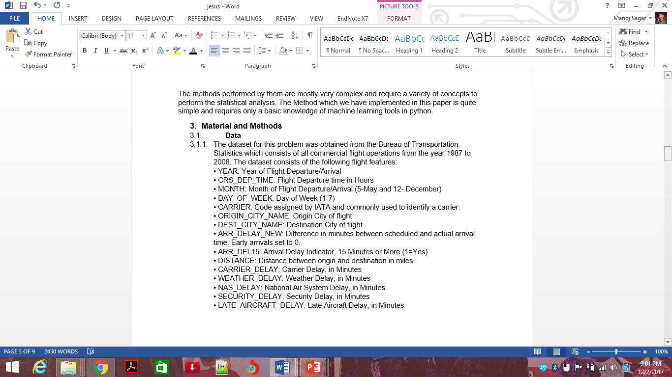
Description of how the solution works (i.e. How to use it)
The data set consists of various attributes from which we need to classify dependant and independent variables.
In this project we have visualized on US geographical map
the airports and airport routes with
respect to its delay intensity.
Then we have divided the data into
Training(70%) and Testing(30%) Dataset
Now we build the logistic regression model

Slide 5

Tools studied in the course to solve the problem
Fundamentals of data science
For me data science is completely new, Dr.Emad had helped understand its importance and applications .
Logistic regression was the second regression model discussed in the course.
Implemented code inJupyter Notebook (Anaconda version 3.6) in python kernel 2.0

Slide 6
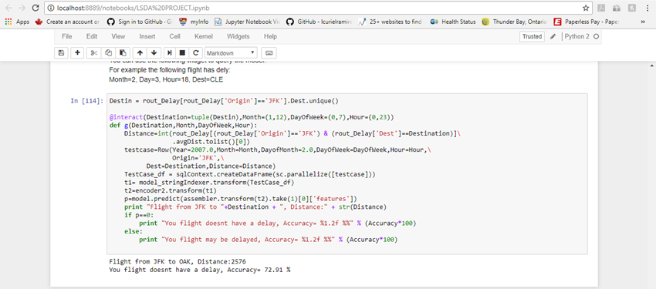
How far you reached in your solution
Was able to predict whether the flight will be delayed or not
The model built was able to attain an accuracy of 72%

Slide 7
How did you find your results (is it a good result? Why?)
The result obtained is satisfactory considering the existing parameters in the dataset.
But even complex data and robust model is required to increase the accuracy of the flight delay prediction.
Since I am new to this field, I consider it as my first practical case rather than a project.

Slide 8
Use it to solve other problem of the same kind
This model can also be applied to train delay prediction.
India has the largest train routes(area wise) and is suffering from huge delays. If a model can be implemented to predict these delays in advance.It would lay a positive effect on its economy.
Have been trying to get dataset from IndianRailways through my closest sources.

Slide 9
Why you use specific procedures (e.g. feature extraction, learning algorithm, error measurement, etc.)
LABELED POINT
A labeled point is a local vector, either dense or sparse, associated with a label/response. In MLlib, labeled points are used in supervised learning algorithms. We use a double to store a label, so we can use labeled points in both regression and classification.

Slide 10
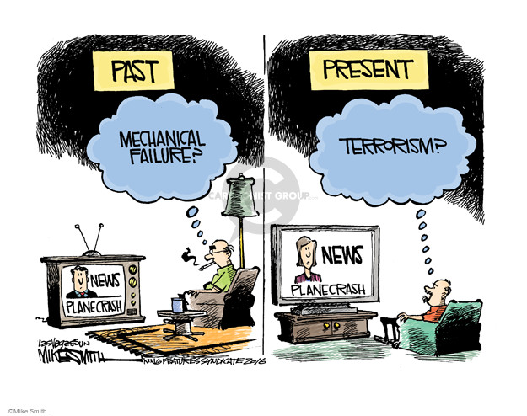
What parts of your solution need enhancement and why?
The dataset needs enhancement because there are many other factors such as mechanical fault in flights, flight service time, fuel filling time etc
These additional datasets might result in acute prediction.

Slide 11
How to validate your work (i.e. how would you know this is a good solution? did you test against other solution).
Trade-off your solution
Changes you made along the way
Any alternative routes you could have taken?

Slide 12
Conclusion:
After the development of the module we have come to a conclusion that the model developed can be used in predicting the delay at the airports.
Challenges
Learnt how to code python for the first time for this project
The only challenge was debugging the code.

